Slide 1
Lecture 8 – Architecture Elements
Notes:
This chapter is about the essential elements you need to build architectures for systems. We will talk about topologies, system redundancy, and failure modes, layering and essential functions in architectures such as flow control and switching, whether the systems are electrical, mechanical, fluid or electronic.

Slide 2
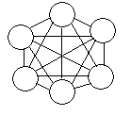
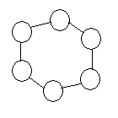
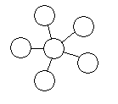

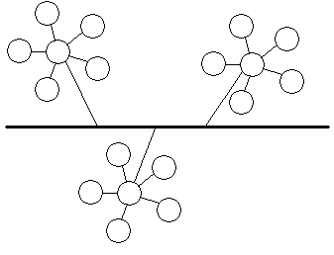
Architecture Basics System Topologies
Mesh Topology Devices are connected with many redundant interconnections between network nodes. In a true mesh topology every node has a connection to every other node in the network. |  | Data
Ring Topology All devices are connected to one another in the shape of a closed loop, so that each device is connected directly to two other devices, one on either side of it. |  | Data, electrical power, hydraulic
Star Topology All devices are connected to a central hub. Nodes communicate across the network by passing data through the hub |  | Data, electrical power, pneumatic
Bus Topology All devices are connected to a central cable, called the bus or backbone |  | Data, electrical power, thermal
Tree Topology A hybrid topology. Groups of star-configured networks are connected to a linear bus backbone. |  | Data, electrical power, hydraulic, pneumatic
www.webopedia.com
Notes:
These are basic topologies for different architectures. The topologies may be implemented in a variety of different systems. For example ring topologies are commonly used in electronic, electrical and fluid systems,

Slide 3
Bus
Bus – a structure that connects multiple elements simultaneously. A key feature of the bus is that it has the same value at every location on the bus
Typical buses have
  Data signals – electrical or optically communicated
  Electrical power
  Thermal control (coolant)
Notes:
A bus is a common architectural topology used in electrical, data and thermal systems,

Slide 4
Spoke Hub vs Point To Point Architecture
In this example - N+5 connections
n*(n-1) connections
Notes:
Spoke-Hub or concentrator topologies are often used when there is a large cost for each of the connections. For example, most airline system architectures in the US started as point to point architectures but evolved to spoke-hub operations for efficiency.

Slide 5
System Architectures – Control Hierarchy
Flight
Control
Navigation
INS
Air
Data
GPS
Centralized – one master control
Distributed – multiple controllers can interact with multiple subsystems – either for different purposes or as redundancy
Federated – subcontrollers control local domains
From Spitzer, Digital Avionics 2nd ed
Notes:
You can implement a control hierarchy in almost any of the physical architectures but the three control hierarchies naturally fit into certain topologies. A centralized control naturally works well in a star topology but it can work equally well in a bus topology or a ring or a tree.
A federated control architecture naturally works well in a tree but can also be implemented in a bus.
The distributed approach works well on a bus or a ring. If the central node of a star tends to inhibit this type of architecture but if the central node just routes communication a physical star can implement a virtual distributed architecture.

Slide 6
Architectural Essentials - Concepts
Layering
Partitioning and firewalls
Graceful degradation – fails ops and fail safe
Must function versus must not function
Parallel versus series
Similar versus dissimilar redundancy
Electrical – Fluid Systems Similarity

Slide 7
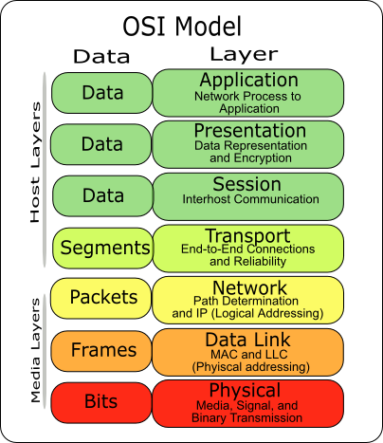
Layering as a technique to deal with complexity
Complexity is one of the biggest challenges in system architecture
Layering is a well demonstrated technique for dealing with complexity in system architectures
One layer of the system isolates the layers above it from the complexity of the layers below it
Each layer presents a user model to the layer above it providing services
Each layer is designed to provide the services required by the upper layer by using the services of the lower layer
Most distribution systems are layered –for example power systems – the 120 volt ac power that comes out of the wall is the result of layers of transformers and distribution systems that link it to hi voltage generation at the power plant
International Standards Organization
(ISO) 7 layer Model for Open Systems Interconnection (OSI)
Notes:
The picture reflects the 7 layer Open Systems Interconnection (OSI) model for data and network communications. When first developed in the late 70’s and early 80’s many thought that the layered model was overly complex and slow. Most of the functions were implemented in software and there were so few data communications options that it seemed like overkill. Nonetheless truly good systems engineers insisted that it would be the basis for a modern interconnected world. Many people proposed “stripped down” versions but in the end as hardware became faster and the lower levels got hardware assistance and as communications options exploded (wireless, faster and faster versions of ethernet, broadband) the power of this approach became evident.
In the layer model, each layer isolates the layers above from the details of how the layers below work. Ever notice how your web browser works the same whether you are hardwire connected to a network, using a modem or using broadband or wireless ? Prior to the OSI model , every application had the details of how it communicated buried in it. Today, modern applications like web browsers use communications services running at layer 4 (transport – TCP), layer 3 network (IP)`, layer 2 (framing part of ethernet or broadband) and layer 1 (actual physical transmission layer),

Slide 8
Partitioning and firewalls
Partitions and Firewalls isolate one part of the system from another
Their purpose is to prevent bad situations from propagating from one part of the architecture to another
Firewalls– a term borrowed from building construction,
  In building architecture, firewalls consist of walls made from materials (such as brick) that won’t burn so that a fire can’t propagate across them
Other types of firewalls
  Computer systems – only allow certain types of transactions across them
  Electrical circuits –
    Circuit Breakers (CB’s) and fuses
    in AC power systems Control Relays (CR’s) isolate system components when interface voltages or currents exceed programmed levels
  Fluid systems – relief valves
  Mechanical systems
    weak links – parts of structure intended to break when the load gets too high to prevent overloads in more critical parts of the structure
    Torque limiters
    Slip clutches

Slide 9
Emergent System Behaviors - Graceful degradation
Graceful degradation is a characteristic of a system so that it does not lose total functionality as failures occur
For example a battery system with three batteries of 10 amp-hour capacity in parallel would have the following characteristics
To perform this way, the system must be diode tied so that a failed short battery does not drain the others
A parallel tank configuration with check valves works the same way to provide graceful degradation in the event of a tank leak
Nominal | 30 amp-hours
After first failure | 20 amp-hours
After second failure | 10 amp-hours
After third failure | 0 amp-hours

Slide 10
Diode Tied Batteries Establish a Redundant Configuration
That Degrades Gracefully
+
+
+
-
-
-
Allowed flow direction
Notes:
For example – here are three batteries in parallel. If one fails, the other two keep working. If they are all equal in capacity, then a failure of one battery causes the system to degrade to 2/3 of its previous capacity.
For this to work, the failed battery can’t drain the other two batteries. That is what the diodes do. The prevent a shorted battery from draining the other two.

Slide 11
Diodes prevent a shorted battery from draining the other two
+
+
+
+
+
+
-
-
-
-
-
-
Parallel Batteries will feed an internal battery short draining the other batteries without diodes
Diode stops the other
Batteries from feeding
The short

Slide 12
Equivalent Architecture In Fluid System
Allowed flow direction
Check valve
symbol
Parallel tanks with check valves to
establish a gracefully degrading configuration of fluid or gas tanks
Notes:
In a fluid system , check valves do the same thing as diodes. Tanks supply fluids at pressure, the same way that batteries provide current at a voltage.
You can imagine that the check valve symbol (which I have amateurishly re-created here) shows the functionality. When flow is in the allowed direction, the bubble is pushed away from the V. When flow reverses , the bubble pushes back against the V blocking flow.

Slide 13
Check Valves Prevent Tanks From Feeding a Leak

Slide 14
Fail Op - Fail Safe
When a system can tolerate a failure and continue operating it is said to be able to Fail Operational or FAIL OP
  Example – if a car battery fails while a car is running, the car is FAIL OP because it will keep running on the alternator
    Can’t start it without the battery though…
When a system can tolerate a failure and go to a safe state it is said to FAIL SAFE
The Space Shuttle Avionics (electronics and computers) were designed to be Fail Op, Fail Op, Fail Safe as a top level system requirement
This was called the FO-FO-FS requirement which said that the shuttle avionics would be operational after two failures and still be able to return the crew after 3 failures
  Resulted in allocated requirements for 4 flight computers, 4 sets of controls of flight surfaces, 4 sets of flight control sensors
  Actuators get 4 different commands normally and vote between the commands
  Flight control software gets 4 sets of every measurement
    With 4 working sensors, the system computes a mean, throws it the farthest from the mean and then selects the sensor in the middle
    With 3 working sensors the middle valued sensor is selected
    With 2 working sensors, the 2 sensors are averaged

Slide 15
Elevators – Fail Safe Design
Elevators are designed to fail safe, in the event of power loss or in the event the cable is cut, brakes are automatically applied
  Elisha Otis was born in Halifax, Vermont. As an adult, he was inspired to design what was then called the "safety elevator" when he was asked to move equipment into the warehouse of his employer, a New York bed factory. Most elevators of the time were extremely dangerous. Otis' employer needed an elevator that could carry people and equipment safely to the upper floors of its new building.
  At the Crystal Palace Exposition in New York in 1853, Otis demonstrated his solution. A large crowd watched breathlessly from the floor far below as Otis ascended in his new elevator. Stopping at a dizzying height, Otis told his assistant to cut the elevator's cord!
  The crowd let out a gasp of relief when the elevator platform did not come crashing to the floor. The key to Otis' invention was a toothed guiderail located on each side of the elevator shaft that caught the elevator car. If the cable failed, the teeth would engage, locking the car in place. (www.about.com)

Slide 16
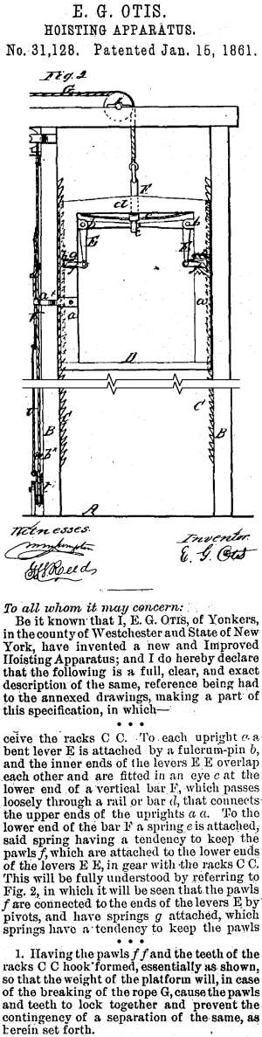
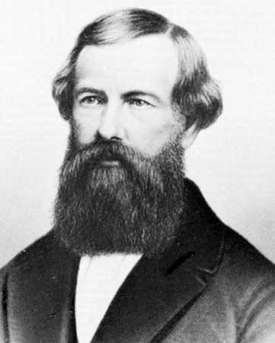
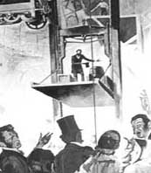
Over 2.2 Million Otis Company elevators and escalators in operation in the world today
It is estimated that they move the equivalent of the entire earth’s population every nine days
http://www.otisworldwide.com/

Slide 17
Must function versus Must Not function
Must Function – are those systems which employ design features such as redundancy or factor of safety to ensure that they will function
Must Not Function – are those systems which employ design features such as redundancy to ensure that hazardous functions are not engaged before it is safe to do so

Slide 18
Parallel versus Series
Parallel Options
  Both active
  Active standby
  Share load versus load shifts to one or the other

Slide 19
Similar versus dissimilar redundancy
Similar redundancy – multiple copies of the same item performing the same function
Dissimilar redundancy – different design components performing the same function (potentially with significantly different principles of operation)
Similar redundancy is vulnerable to generic failures i.e. a failure common to all parts of the same design

Slide 20
Similarity – electrical and fluid systems
Function | Electrical | Fluid
Flow | Current | Mass flow
Potential | Voltage | Pressure
Flow Control – on/off | Switch, relay | valve
Flow direction | diode | check valve
Flow regulation | transistor | regulator
Potential regulation | amplifier | Fixed orifice
Isolation | Fuse or circuit breaker or opto -isolator | Relief valve

Slide 21
Architectural Essentials
- Components
Switch, relay | valve
diode | check valve
transistor | regulator
amplifier | Fixed orifice
Fuse or circuit breaker | Relief valve

Slide 22
Flow Control – On/Off – Switch, Relay and Valve
Whether flow is materials or electrons in a system, we need an architectural element to turn it on and off
In electrical systems this is accomplished with switches (manual) or if electrically controlled it is called a relay
In fluid systems, this function is accomplished by a valve, either manual or remotely controlled
  Remote control may be electrical (solenoid), pneumatic (gas) or hydraulically (fluid)
Switch elements in parallel are redundant for MUST FUNCTION applications
Switch elements in series are redundant for MUST NOT FUNCTION applications
If A fails to close
And B closes, function still occurs
A
B
A
If A fails closed,
Then B prevents function
B

Slide 23
Switches are not just manual devices
Switches may be manually closed or opened OR
  They may be activated by a mechanism forcing the switch contacts closed (or open)
  They may be pressure activated (pressure switch)
  They may be activated by temperature (thermostat)

Slide 24
Normally open, normally closed valves and relays versus bistable devices
Valves and relays may be spring loaded to go to a default position when they are de-energized
  These are called normally open or normally closed
  These are very useful in establishing a fail safe system in the event of power loss
Valves and relays may also be stable in either position when power is removed
  These are called bistable – they are stable in either state
  They are good for holding position when power is lost

Slide 25
Flow direction - One way flow – diodes and check valves
In systems it is necessary to establish an architecture that guarantees one way flow
This is necessary to avoid SNEAK FLOWS
  SNEAK FLOWS are unintended flow paths through the system
Diodes perform this task for us in electrical and electronic systems
Check valves perform this function in fluid and gas systems

Slide 26
Isolation - Fuses, circuit breakers, relief valves
In systems it is often necessary to isolate flow in a system when certain conditions are exceeded
  Fuses “blow” when current is exceeded
  Circuit Breakers “pop” when current is exceeded
  Relief Valves “pop” when pressure is exceeded
Fuses and circuit breakers interrupt the flow. Relief valves just reduce the amount of potential energy
  Zener diodes in electrical systems can also be used to limit voltages to a certain value
  Pressure regulators also can be used in fluid mechanical systems
Opto-isolators consist of a light emitting diode coupled to a photosensor
  there is no electrical connection between inputs and outputs
  This isolates the downstream electronics from any transients that occur on the upstream side
    In worst case, the LED burns out..but high voltage transients are not passed thru the isolator

Slide 27
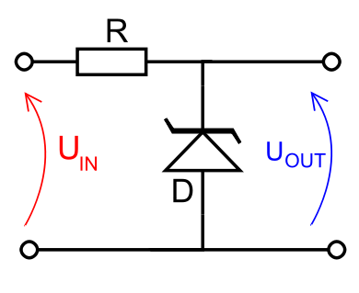
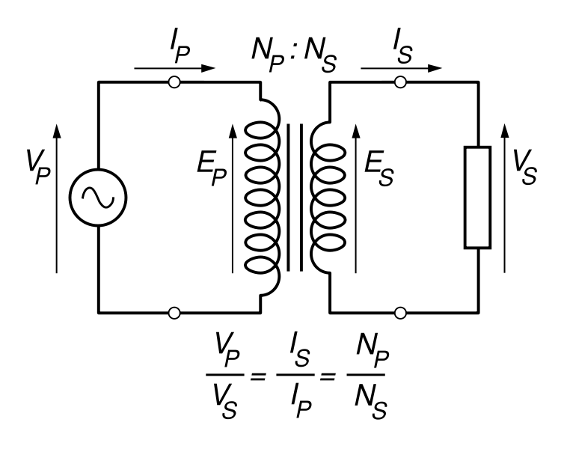
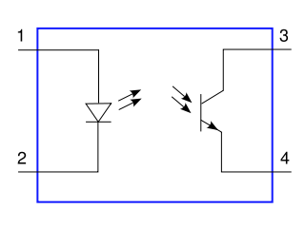
Zener Diode
Voltage reguated here
Primary coil
Secondary coil
input
output
Transformer – AC Only, 2 way
Opto-Isolator
Notes:
The Top diagram shows a zener diode in a circuit. If the Zener diodes are used to "clamp" a voltage in order to prevent it rising higher than a certain value. This might be to protect a circuit from damage or it might be to "chop off" part of an alternating waveform for various reasons. Zener diodes are also used to provide a fixed "reference voltage" from a supply voltage that varies. They are widely used in regulated power supply circuits. A ZENER diode allows current to flow in both directions. In the "forward" direction, no current will flow until the voltage across the diode is about 0.7 volts (as with a normal diode). In the reverse direction (cathode more positive than the anode) no current will flow until the voltage approaches the "zener" voltage, after which a LOT of current can flow and must be restricted by connecting a resistor in series with the zener diode so that the diode does not melt! (http://www.satcure-focus.com/tutor/page3.htm)
The lower left shows a transformer. As we know from basic physics a transformer consists of two sets of wire wound around a ferrous core. The voltage on the primary coil causes a voltage on the secondary coil according to the ratios of turns of wire in the two coils. So if the Secondary has 10 times as many coils as the primary, then the voltage in the secondary is 10 times that of the primary. This is called a step-up transformer. If the secondary has less coils than the primary than the voltage is decreased on the secondary and it is called a step-down transformer. The transformer isolates the secondary from the primary because the ground reference of the voltage is not shared. This allows the electrical engineer to connect very high voltage systems to lower voltage systems such as control computers without burning the control computers out.. In this way the circuitry of the computer is isolated from the circuitry of the external circuitry and a short in the input cannot short out the computer and damage it.
The lower right is an opto-isolator. When voltage is applied to the input it causes a Light Emitting Diode (LED) to generate voltage. A phototransistor receives that voltage and generates a voltage proportional to the light. This allow the electrical engineer to send a signal without electrically connecting two parts of the circuit. No electrons actually pass through the optical coupling between the LED and the phototransistor. This type of circuit is often used to connect computers to switches and other devices. The interface limits the amount of current that can pass through the output side. In this way the circuitry of the computer is isolated from the circuitry of the external circuitry (typically switches, relays and indicators and a short in the input cannot short out the computer and damage it.

Slide 28
Flow Regulation – regulators and transistors
In systems it is sometimes necessary to limit the amount of flow
  In electrical systems this can be done with current limiting resistors but a better technique is transistor based control
  In mechanical systems, this is performed by flow regulators

Slide 29
Potential Regulation – Amplifiers and Orifices
In order to regulate the amount of potential energy in an architecture, we use devices such as
  Electrical systems - all of these devices change voltage which is potential energy
    amplifiers
    DC-DC converters
    transformers (ac systems only)
  Fluid mechanical systems
    Over their effective range, Orifices take a wide range of input pressure and always provide output at the same pressure by varying the output flow rate so that mass flow rate into and out of the orifice is the same

Slide 30
Any Questions ?

